Slide 1
The Types of Business Ownership
By: Matthew Guyett

Slide 2
Advantages of Sole Proprietorship
A sole proprietor has complete control and decision-making power over the business.
Sale or transfer can take place at the discretion of the sole proprietor.
No corporate tax payments.
Minimal legal costs to forming a sole proprietorship.
Few formal business requirements.

Slide 3
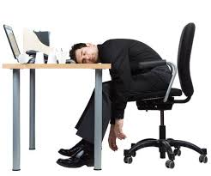
Disadvantages of Sole Proprietorship
Help personally responsible for business debts
Help responsible to pay employee liabilities
All responsibility on the single owner
Relies a lot on loans, and personal assets to initially finance

Slide 4
Advantages of Partnerships
Easier to establish than a Sole Proprietorship
Able to have more loans with more people
There is more knowledge, skills, and contacts
Able to split expenses

Slide 5
Disadvantages of Partnerships
You are liable for the actions of the other person
Have to decide on profit sharing (less profits for you)
You may disagree with the other person, causing trouble
If your business fails and you only own 5%, and the other
95%, If they cannot pay all their debt, you will have to pay for it

Slide 6
Advantages of Corporations
Liabilities are limited to shares put into the corporation
The corporation is considered a legal person with perpetual existence. It exists until it is liquidated and death or change in ownership has no effect on the corporation.
Additional capital can be raised easily through stock markets
The ownership is represented by the number of shares held by a person, and this makes changing ownership easy.

Slide 7
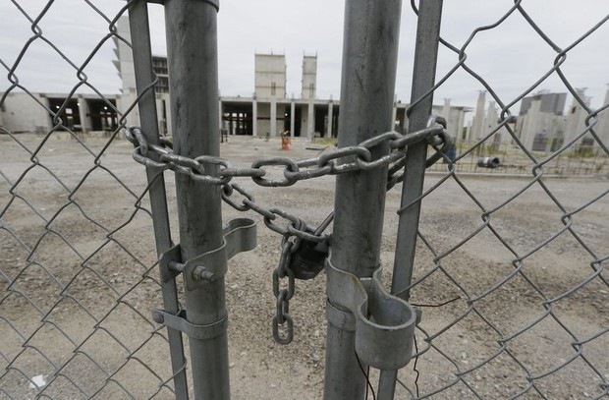
Disadvantages of Corporations
Very difficult and complex to set up. You need registration with the central regulatory authority and listing on a stock exchange which has a lot of requirements related to the amount of capital and number of directors
Corporations have double tax. First of all the corporate income is taxed at a flat rate and then the dividends paid to the shareholders is taxed

Slide 8
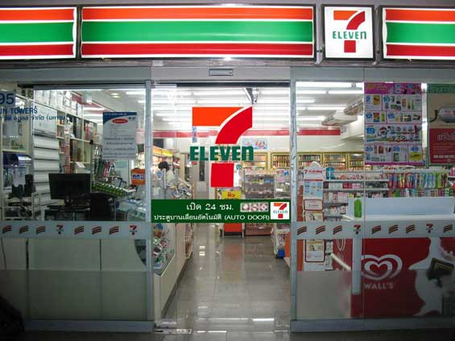
Advantages of Franchises
You can go into a business for your own good, with help of others
Have a certain level of independance to operate
Has a customer base already with a known name brand
Have a certain level of qualityconsistency, which is attractive to customers

Slide 9
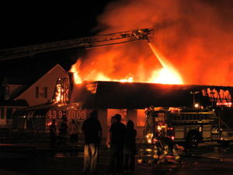
Disadvantages of Franchises
Not completely independent, as you have to follow rules/restrictons set by the franchisor
There is a large startup cost, as well as royalties and advertisement fees that must be payed
If other another franchisee in your business gets a bad image, it might affect your franchise
A set duration for you to own the franchise, and no or very little say in terms of termination

